Slide 1
Model Based Fast Protection System for High Power RF Tube Amplifiers Used at European XFEL Accelerator
Lukasz Butkowski
Notes:
How to edit the title slide
Upper area: Title of your talk, max. 2 rows of the defined size (55 pt)
Lower area (subtitle): Conference/meeting/workshop, location, date, your name and affiliation, max. 4 rows of the defined size (32 pt)
Change the partner logos or add others in the last row.

Slide 2
Outline
Introduction (XFEL, Klystron)
Protection system overview
Protection functions
Klystron Model
FPGA implementation
Model verification
Event detection, reaction time
Notes:
Before you start editing the slides of your talk change to the Master Slide view: Menu button “View”, Master, Slide Master:
Edit the following 2 items in the 1st slide: 1) 1st row in the violet header: Delete the existent text and write the title of your talk into this text field 2) The 2 rows in the footer area: Delete the text and write the information regarding your talk (same as on the Title Slide) into this text field.
If you want to use more partner logos position them left beside the DESY logo in the footer area Close Master View

Slide 3
Introduction
European X-ray Free-Electron Laser (XFEL)
Electrons accelerated to an energy of up to 17.5 GeV
27 RF underground stations over 2.1km long accelerator
Each RF station is driven by Multi Beam Klystron
The klystron is a specialized linear-beam vacuum tube which is used as high power RF amplifier
Multi Beam Klystron at XFEL:
Can provide up to 10 MW of peak power at 1.3GHz , 10Hz, 1.7 ms HV and 1.5 ms RF pulse
High gain ~50dB and efficiency ~65%
Very expensive device!
Klystrons undergoing frequent failures and have limited lifetime.
Lifetime of the tube should be in excess of 60,000 hours - not easy to achive.

Slide 4
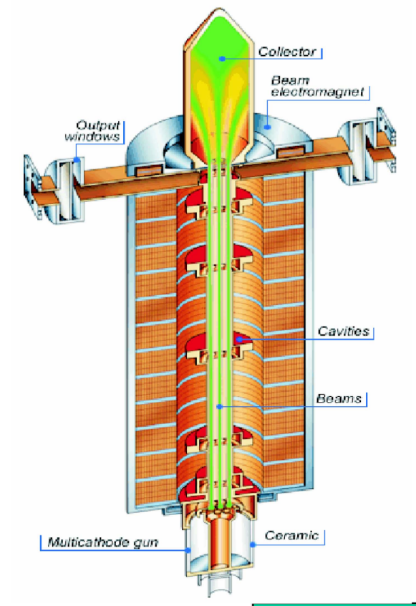
Introduction
Destructive factors:
Bad vacuum: indicates ions current, RF and HV breakdown;
RF breakdowns: destructs cavity surface and can pollute RF window that increases reflected power and probability of RF breakdown;
Gun arc: destructs the cathode and anode surface and can pollute HV insulator and cathode
Work in deep saturation: beam loss, bad vacuum.
High RF reflections: beam loses
To prevent occurrence of the destructive factors the fast interlock is required.
System should detect exceptional events and reacts as fast as possible by switching off driving signal;
Thales TH1801

Slide 5
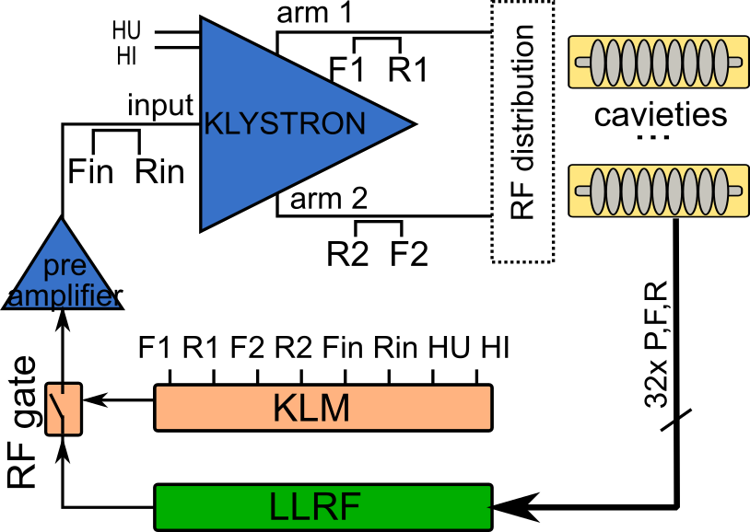
System overview
Klystron signals for monitoring:
6 RF signals from directional couplers
R1 – reflected power at first klystron arm;
F1 – forward power at first klystron arm;
R2 – reflected power at second klystron arm;
F2 – forward power at second klystron arm;
Rin – reflected power at klystron input;
Fin – forward power at klystron input;
2 DC signals
HU – klystron high voltage;
HI – klystron current;
Protection System
Low Lever RF controller
Fast klystron interlock is called Klystron Lifetime Management system (KLM).
System monitors available signal from klystron and react when klystron parameters are over normal values
It compares measured values with estimated model
Reaction on event is to switch off driving signal by opening RF gate

Slide 6
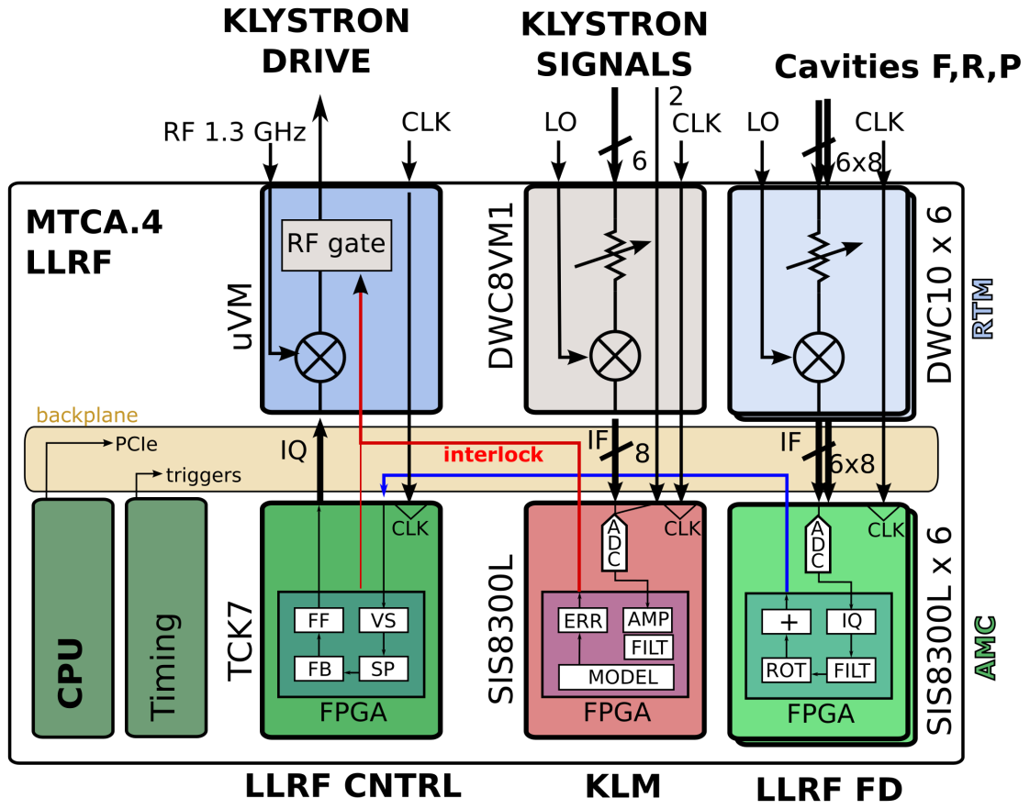
System overview
For the XFEL the Mi-cro TCA technology (MTCA.4 or xTCA) was chosen to support LLRF system
Klystron lifetime management is integrated LLRF system in one crate.
It consists of a Rear Transition Module and Advanced Mezzanine Card (RTM-AMC) pair with down-converts and digitizer board.
Interlock line on backplane connected to RF gate on vector modulator board
KLM activate interlock signal on event and switch off RF driving signal
Analog part
Digital part

Slide 7
Protection functions
Reflection Limitation
Reflection amplitudes on input and outputs $(A_{Rx})$ of klystron are checked and if they cross limitation value ($A_{RxLIM})$, error will appear. Error condition:
Error condition: $A_{Rx}≥A_{RxLIM}$
Amplitude limitation is a function of forward power: $A_{RxLIM}=f(A_{Fx})$
Forward Check
Forward amplitude at output ${(A}_{OVS})$of klystron is checked if it is the same as expected ($A_{OEXP})$. If the difference cross protection level ($A_{FLIM}$) error will appear.
Error condition:$A_{OEXP}− A_{OVS}≥A_{FLIM}$
Expected amplitude $(A_{OEXP})$ is a function of input amplitude ${ (A}_{in})$ and klystron high voltage$(U_{H})$:
$$A_{OEXP}=f(A_{in},U_{H})$$

Slide 8
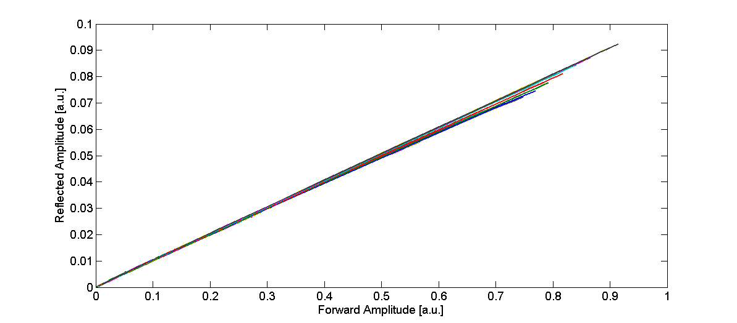
KLYSTRON MODEL
Reflection Amplitudes
At the klystron input and outputs during normal stable operation impedance should not change
Maximum reflection can be calculated from reflection coefficient:
Amplitude Limitation Value
$$Γ= \frac{V_{ref}}{V_{for}}= \frac{Z_{L}−Z_{0}}{Z_{L}+Z_{0}}$$
$V_{ref}$ is reflection voltage,
$V_{for}$ is forward voltage,
$Z_{L}$ is load impedance and
$Z_{0}$ is klystron impedance
$$A_{RxLIM}=f\left(A_{Fx}\right)=a⋅A_{Fx}+ b$$
$a$ is reflection coefficient and
$b$ is an offset for protection level.
Relative percentage error between estimated amplitude calculated from approximated model and measured value

Slide 9
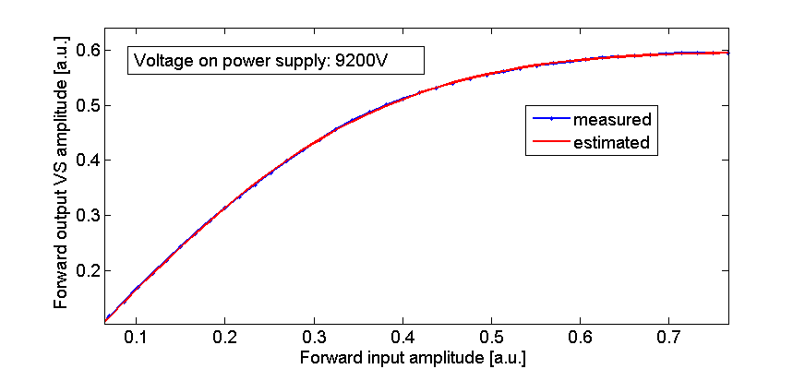
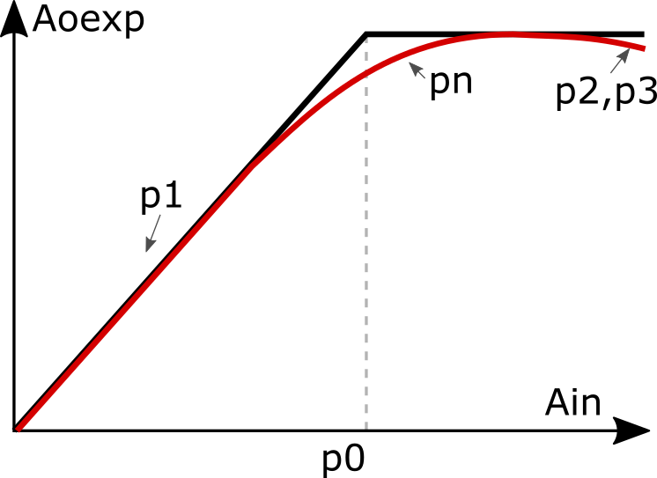
KLYSTRON MODEL
Expected Forward Output Amplitude
Klystrons are highly nonlinear devices
Amplitude to amplitude (AM/AM) conversion can be characterized by modified Rapp’s model
Model for constant klystron voltage is:
$$A_{OEXP}= \frac{p_{1}⋅ A_{in}+p_{2}}{{\left[1+{\left(\frac{A_{in}}{p_{0}}\right)}^{p_{n}}\right]}^{1/p_{n}}}+p_{3}$$
Klystron input to output characteristic curve for one voltage set, R²≈1

Slide 10
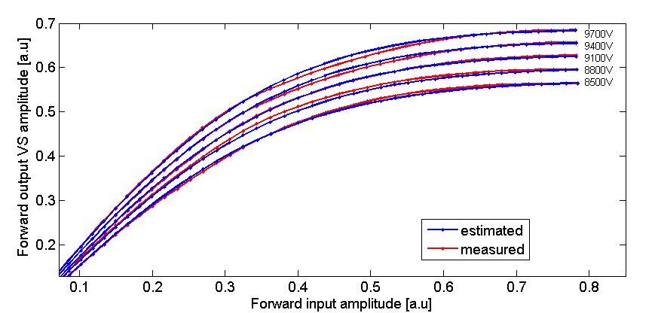
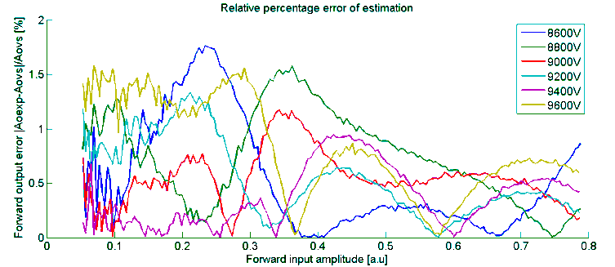
KLYSTRON MODEL
Expected Forward Output Amplitude
Modified Rapp’s Model with included klystron high voltage
$$A_{OEXP}=f(A_{in}, U_{H})= \frac{p_{1}⋅ A_{in}⋅U_{H}+ p_{2}⋅A_{in}+{ p}_{3}⋅U_{H}+ p_{4}}{{\left[1+{\left(\frac{A_{in}}{p_{0}}\right)}^{p_{n}}\right]}^{1/p_{n}}}−p_{3}⋅{ U}_{H }− p_{4}$$
Relative percentage error between estimated amplitude calculated from approximated model and measured value
Transfer curves of THALES TH1802 MBK for 5 different power supply voltages set, R²=0.995

Slide 11
FPGA implementaion
Algorithms were implemented in FPGA and were optimized for lower latency
For field detection non-IQ digital demodulation is used
Low pass filters are implemented as a simple moving average over four samples
Model implements modified Rapp model formula and reflection limitation
Error detection: comparators of model with actual values
Event detection block diagram

Slide 12
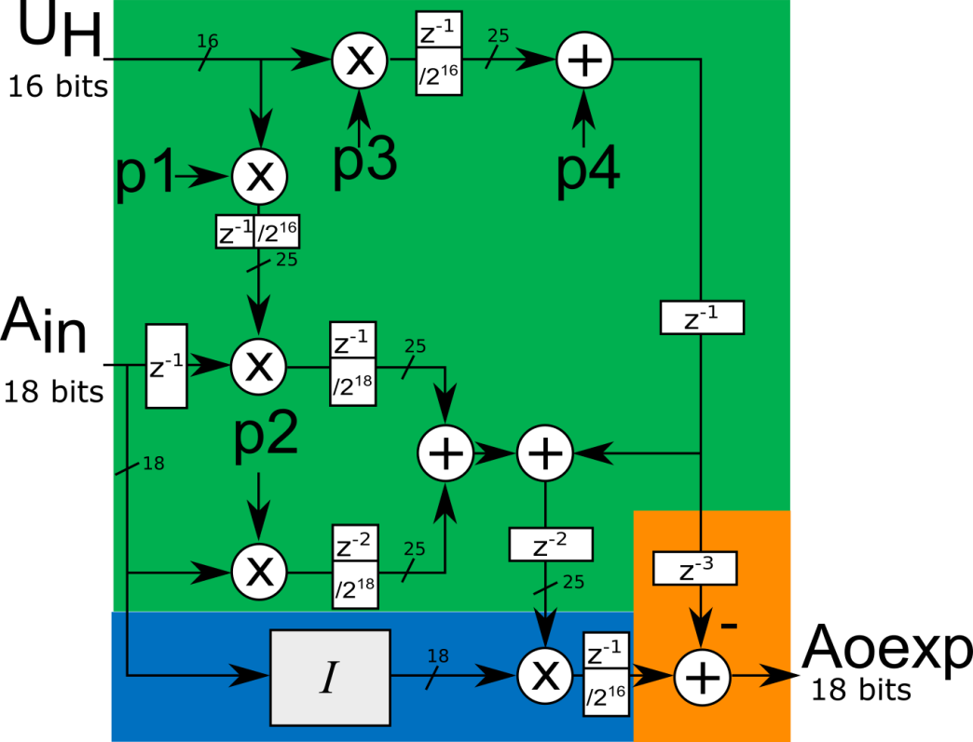
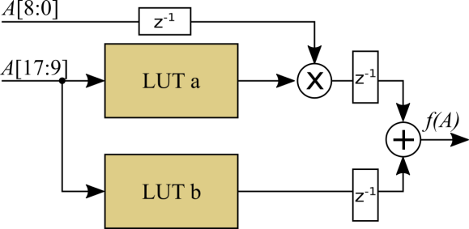
FPGA – Rapp’s Model implementation
$$A_{OEXP}=\frac{1}{{\left[1+{\left(\frac{A_{in}}{p_{0}}\right)}^{p_{n}}\right]}^{1/p_{n}}}⋅{(p}_{1}⋅ A_{in}⋅U_{H}+ p_{2}⋅A_{in}+{ p}_{3}⋅U_{H}+ p_{4})−{(p}_{3}⋅{ U}_{H }+ p_{4})$$
Calculations are pipelined
Linear interpolation on two LUT tables used for part of the function
Precision of multiplications is 18bits times 25bits
Adders are 25bit
Pipe takes 6 clock cycles
Block diagram of FPGA implementation of expected amplitude estimation
linear interpolation
Interpolator $I$ with 512 points implementation

Slide 13
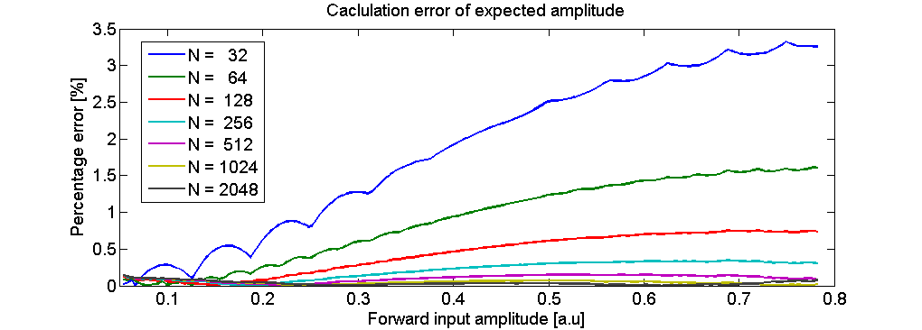
FPGA – Rapp’s Model Calculations error
Quantization of coefficients and use of interpolation increase calculations error of model
For 512 point linear interpolator calculation error is better then 0.1% in compare to foliating points results
FPGA calculation error of expected output amplitude for the different number of interpolation points

Slide 14
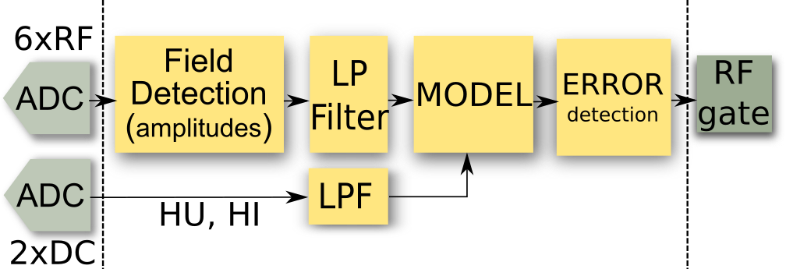
FPGA implementaion – Delay estimation
Module name | clock cycles | Time (81MHz clock)
ADC (SIS8300L) | 14 | 168 ns
Amplitude detection | 6 | 72 ns
Filter | 1 | 12 ns
Model Estimation | 6 | 72 ns
Error detection | 2 | 24 ns
RF gate |  | 30 ns
FPGA total | 15 | 180 ns
Digital total |  | 378 ns

Slide 15
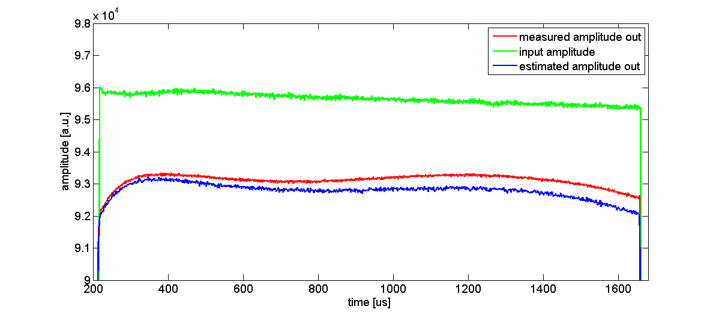
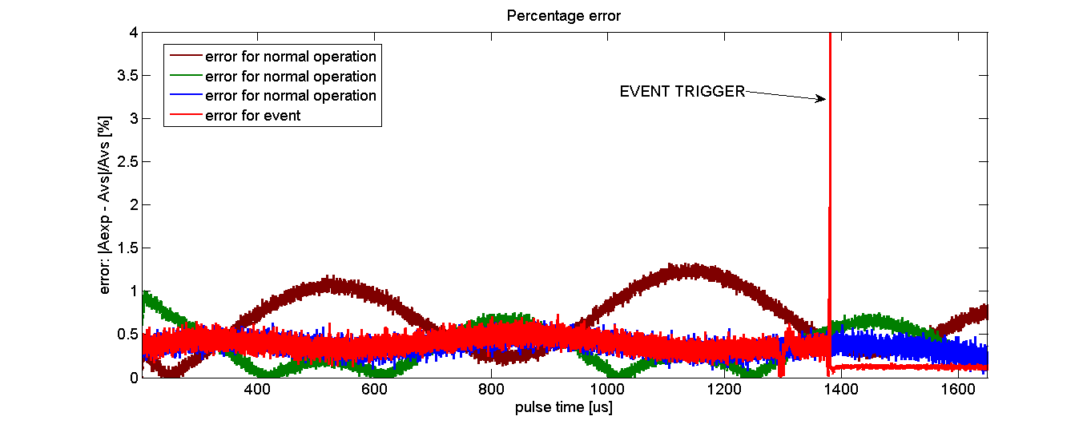
Model Veryfication
Verification of online model calculation was done by comparison of estimated amplitude with forward output amplitude vector sum during RF pulse
Many experiments shows that in specific operation point the klystron can show nonlinearities that are not included in the model
Difference between model and measured value <1.5%
Measured and estimated output klystron amplitudes during RF pulse
Relative percentage error between estimated and measured amplitude at klystron output for different operating points

Slide 16
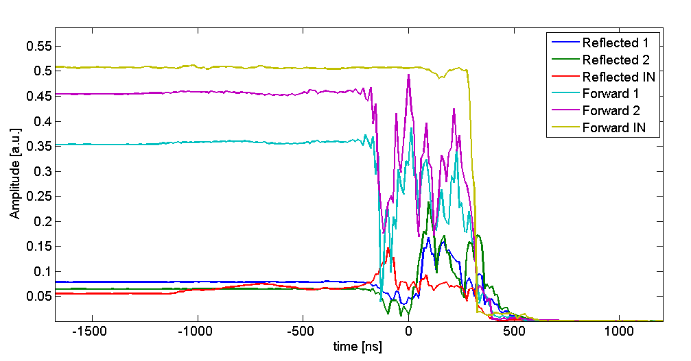
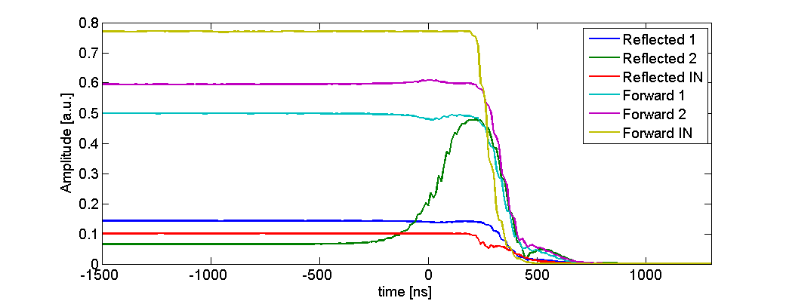
Events
Amplitude curves for all RF signals during RF breakdown event
All tests were done at klystron test stand
There were many events cached during operation of the klystron, main RF events are:
High out reflection
RF breakdown
Total reaction time including digital and analog part of system is in a range of 500ns to 600ns
Time 0 on plots is point where event was detected in FPGA and action was taken, and RF driving signal was switched off.
Amplitude curves for all RF signals during high reflection at output

Slide 17
Conclusions
Model of klystron was properly derived, implemented and verified, relative percentage error less then 1.5%
Fast protection system for Klystron was successfully implemented and tested
System can properly detect exceptional events
Reaction of system is in a range of 500 ns

Slide 18
Thank you for attention

