Slide 1
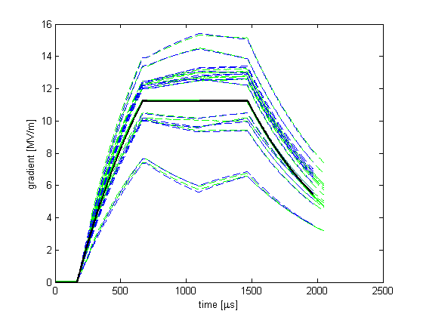
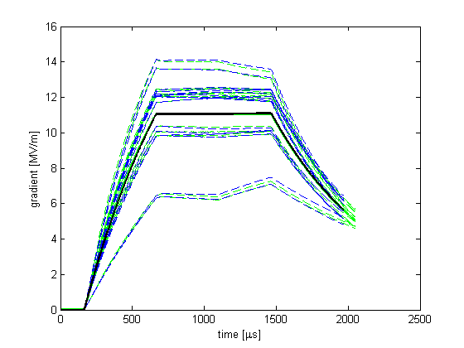
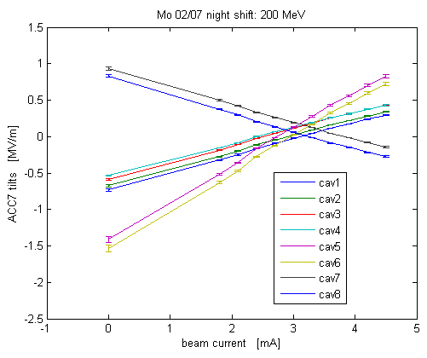
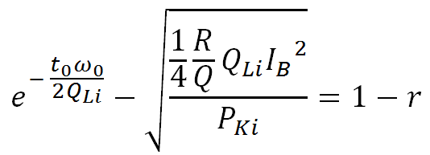
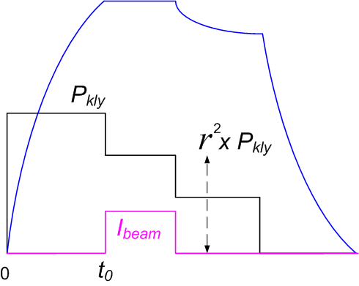
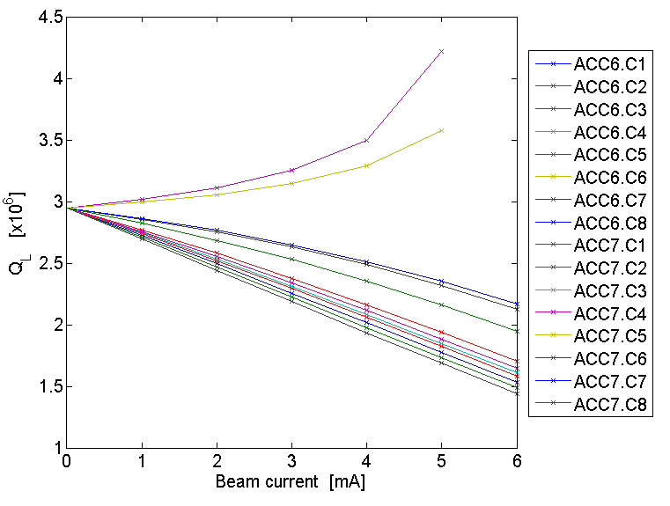
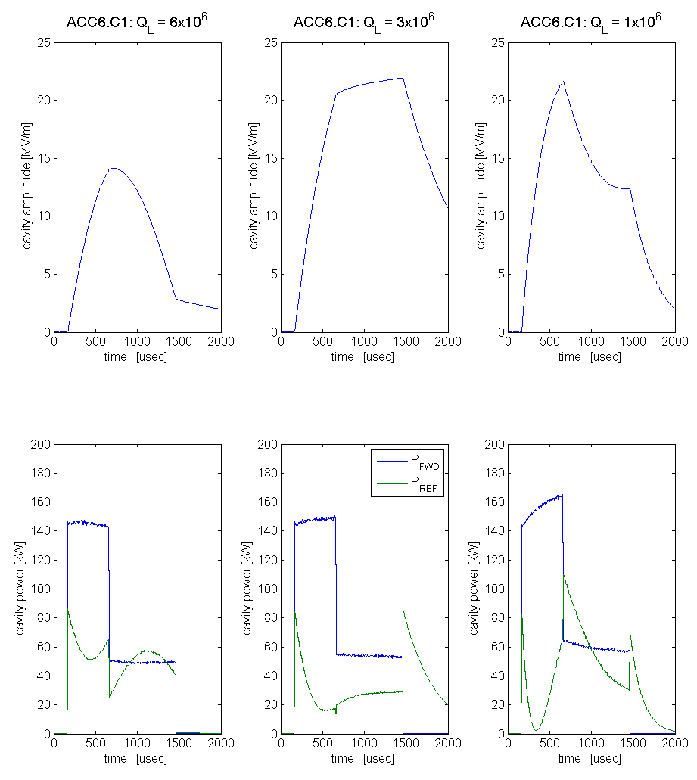
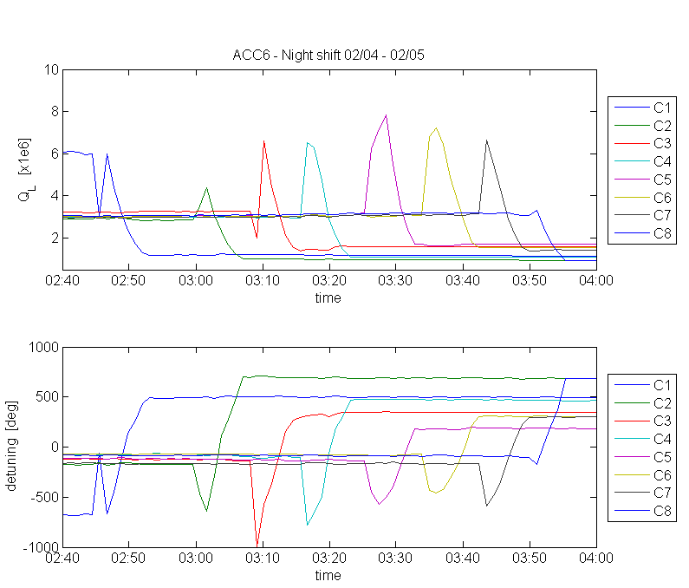
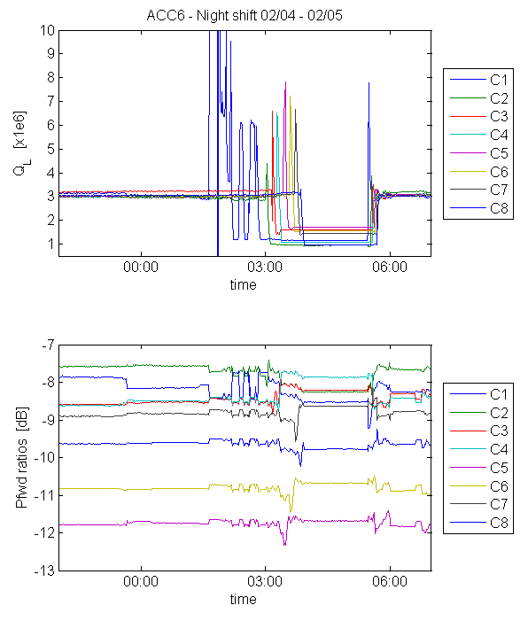
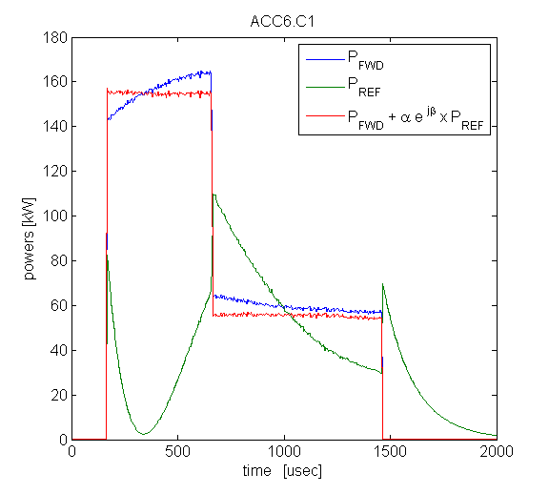
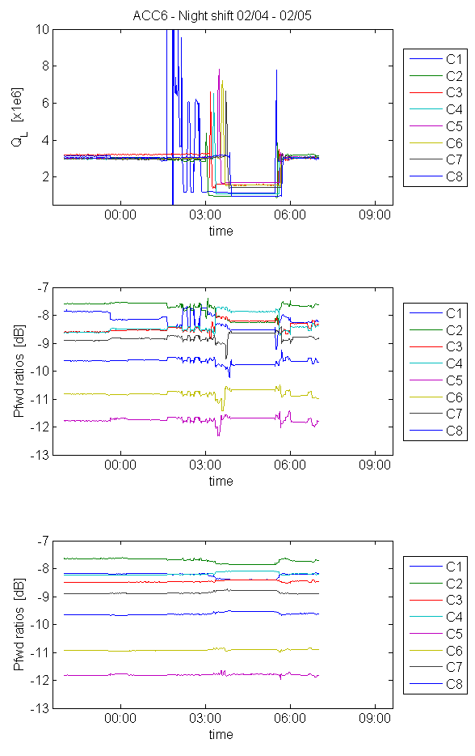
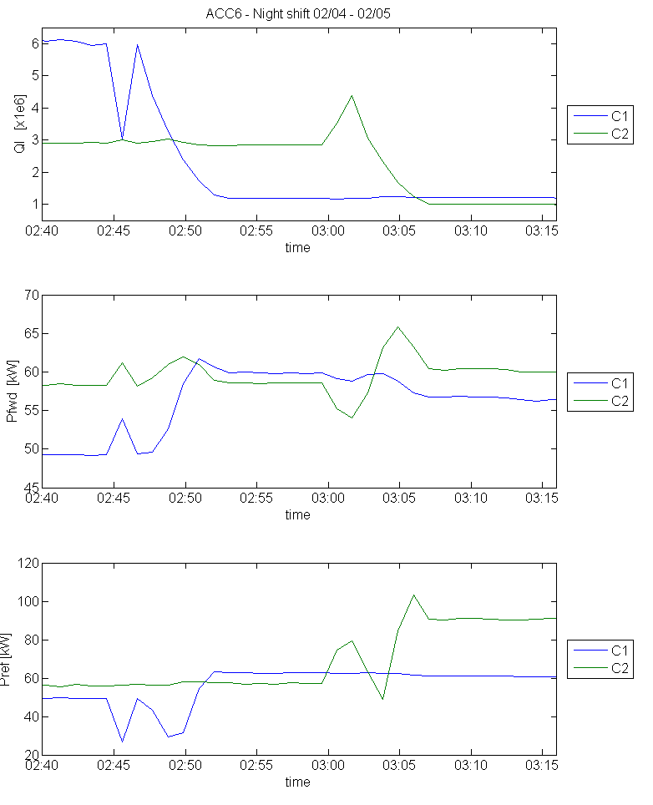
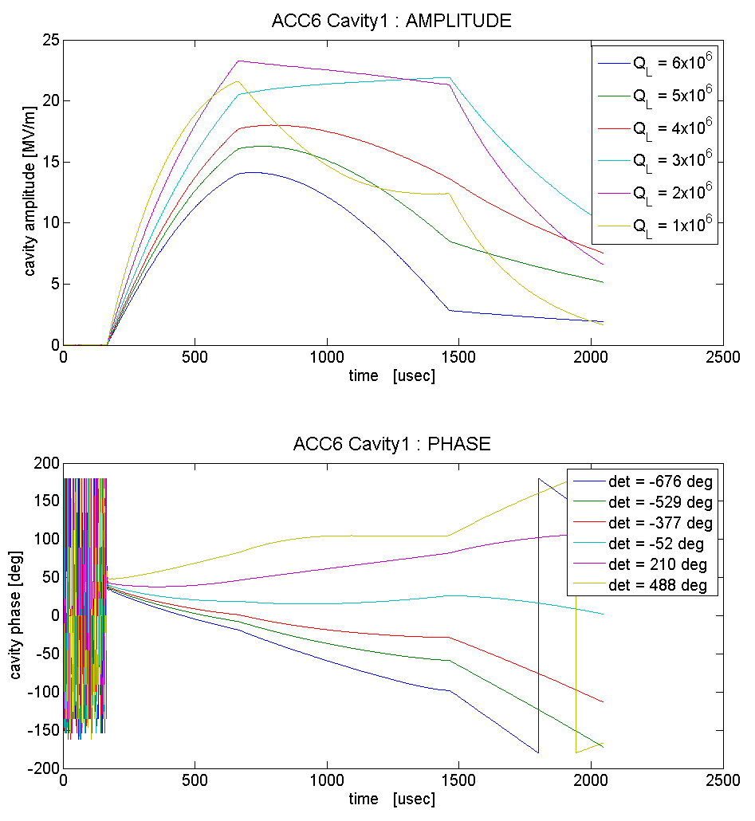
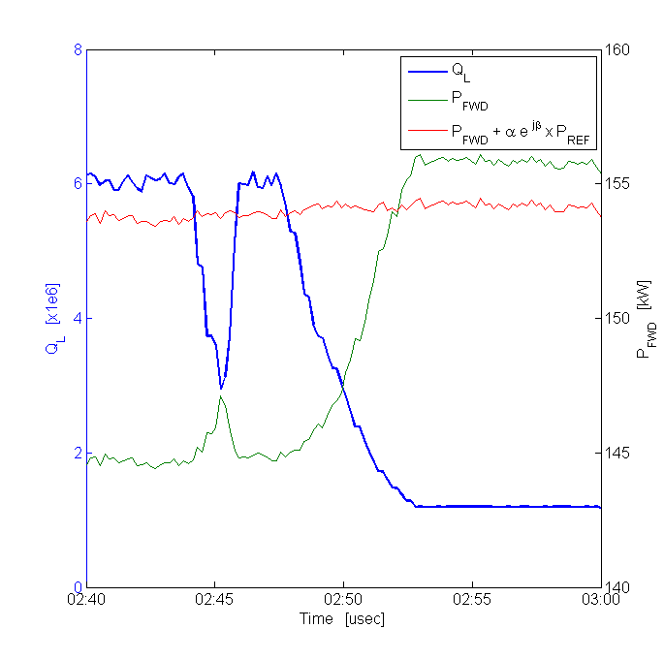
Analysis of coupling effect, observed during the February 2011 9mA run at FLASH
Julien Branlard, with the FNAL-ILC collaboration
Abstract
FLASH ‘fixed’ Power Distribution
Flattening Individual Cavity Gradients
To prevent transverse beam kicks due to cavity misalignment, the International Linear Collider (ILC) requires individual cavity gradient vectors to be held constant over the RF flattop in addition to the gradient vector sum. The proposed solution consists of adjusting the cavity loaded Q's (Q_{L}) to compensate for beam induced gradient tilts. To illustrate its feasibility, this approach was implemented at FLASH during the 9mA-test in DESY in February 2011. During this study, numerous coupling effects between Q_{L}, cavity detuning and inter-cavities power distribution were observed. For example, up to 5% change in Q_{L} could be induced by adjusting the loaded Q of a neighboring cavity. Similarly, +/-0.5 dB fluctuations in the power distribution between cavities were observed during Q_{L} adjustments. Details and characterization of these observed coupling effects are reported in this contribution.
The fixed power distribution at FLASH ACC6 and ACC7 imposes to rely solely on changing the QL to flatten the cavities. As reported in other papers, the proof of principle was verified and individual cavity gradients were flattened to ~1%
FLASH DAQ data
FLASH DAQ data
Why do we care about individual flat gradients?
“Effect of Cavity Tilt and RF Fluctuations to Transverse Beam Orbit Change in ILC Main Linac”, K. Kubo, Jan. 2010
simulated data
simulated data
vector sum
vector sum
On this plot, one can see the measured tilts induced by beam loading. Individual cavity tilts result in an undesired transverse kick to the beam.
Simulation and experimental validation of ACC6 and ACC7 cryomodules at FLASH under now beam (left) and under 3mA beam loading (right). Although the vector sum is kept flat, individual cavity gradients above (below) show a positive (negative) tilt, as seen on the left. On the right, the same cavities after Q_{L} change are flat during beam.
*
→ assumes “perfect” tuning
→ solve for Q_{Li} when possible
“Good gradients in seconds flat”, by Leah Hesla ILC NewsLine, 4 August 2011
cavity i loaded Q
cavity i forward power during fill time [W]
DC beam current [A]
One can compensate for beam induced tilts by adjusting individual powers and/or Q_{L}s. This plot shows a simulation of the optimal Q_{L} values required to maintain a flat top for all cavities, as a function of beam current.
fill time (∼ beam arrival time) [s]
fill time to flat top voltage ratio (including beam compensation)
Full results are reported in “Results from 9mA studies on achieving flat gradients with beam loading” - P_{K} |Q_{L} studies at FLASH during the Feb. 2011 test in DESY, J.Branlard, ALCPG11 – 19-23 March 2011 – Eugene OR, USA
* “Note on solving QL for flat gradients at FLASH ACC6 and ACC7”, J. Branlard, Feb 2011, FNAL Beams-doc-3796
“Analytical solution to the cavity tilt problem.docx”, G. Cancelo, Feb 2011
Q_{L} – Detuning Coupling
Source: V. Katalev : flash_wg_20100214-1.xls
“PkQl-like control for ACC6/7 at FLASH”, Shin Michizono, Sept. 2010
“To flatten the cavity gradient for ACC6/7” , Shin Michizono, Nov. 2010
Q_{L} – P_{K} Coupling
Corrected forward powers
When looking at the forward and reflected power during a pulse, the corrected power has a profile closer to the text book diagram.
During QL scans:
The motors changing the loaded Q’s are exercised to measure the Q_{L} tuning range of each cavity.
It appears that the measured detuning is affected by the Q_{L} scan.
During QL scans:
We observed variations in the P_{FWD} ratios during the Q_{L} scans, (up to 1.5dB). The forward power ratios are calculated for each cavity as the ratio of the forward power to the vector sum power, averaged over the flat top region.
Ratio plot with corrected forward powers
The top plot shows the QL values as a function of the night-shift time. The Q_{L} scan time period is clearly seen. The middle plot shows the forward power ratios calculated with the direct forward power. The bottom plot shows the ratio calculated with the corrected forward powers.
Q_{L} changes (top plot) induce a detuning measurement change (bottom)
Pref – Pfwd coupling
For the two left-most plots (Q_{L} = 6 and Q_{L} = 3x10⁶), the forward power profiles are similar. The Q_{L} scan was performed open loop, so one should not see an influence on the forward power, but only on the reflected power. Indeed, changing Q_{L} is equivalent to changing the cavity impendance so the reflected power changes with Q_{L}. On the right plot (Q_{L} = 10⁶) however, one sees a net difference in the shape of the forward power, which is unexpected. One can also notice that for this case, the reflected power changes phase around 300 usec, when Pref=0)
This apparent “coupling” is actually due to Lorentz force detuning. Indeed, changing Q_{L} can have a strong impact on the cavity amplitude, changing its peak gradient by >10 MV/m as illustrated below. Lorrentz force detuning scales with the square of the gradient:
which can account for ~1kHz detuning for gradients ranging from 3 MV/m to 25 MV/m
Example study: the particular case of ACC6 cavity 1 and cavity 2:
Looking at the forward and reflected power gives some insight on this coupling effect as illustrated below for the case of ACC6 cavity 1 and 2
Q_{L}(1) scan
Q_{L}(2) scan
Corrected forward powers
To truely compare the power ratios for different QL values, one needs to take the reflected power of the cavity and the reflected power of its paired cavity into account :
where each coefficient is a complex number
This corresponds to the directivity of the circulator and the isolation at the waveguide splitter.
Note that one needs to work with voltages, not powers, to take the phase into account. Then one can convert the corrected voltages into their corresponding powers.
$${\text{ratio}}_{i} =\frac{P_{FWD}i}{\sum{P_{FWD}i}}$$
P_{FWD}(2) affected
P_{FWD}(1) affected
$${\text{ratio}}_{i} =\frac{{\left|\vec{V_{FWD}i}+\left(α_{i}e^{−iθ}\right)×\vec{V_{REF}i}\right|}^{2}}{{\left|\sum{\vec{V_{FWD}i}+\left(α_{i}e^{−iθ}\right)×\vec{V_{REF}i}}\right|}^{2}}$$
P_{REF}(2) not affected
P_{REF}(1) not affected
dependence on Q_{L} can not longer be seen
Amplitude and phase plot for ACC6 cavity 1 at different stages of the Q_{L} scan. The dramatic impact of the Ql change on the cavity gradient changes the detuning due to Lorentz forces.
We can see from plot 2 and 3 that the forward power of cavity 1 is affected by the Q_{L} scan of cavity 1 and cavity 2. However, the reflected power of 1 is only affected by the scan of cavity 1.
In this study, the coupling coefficients have been calculated by hand without any effort to automation or optimization effort. Typical values are:

